Slide 1
Formalizing uncertain knowledge
Tanel Tammet

Slide 2
Overview of the area
Not related to agent/person:
Discrete:
Multi-valued logic
Default logic
Other model-based systems
Non-discrete:
Probabilistic (several types!)
Fuzzy (possibilistic)
Related to agent/person (not covered in this presentation):
Logics of knowledge and belief
Other “meta”-systems

Slide 3
Why different uncertainties 1
Real-life rules have exceptions: not all birds fly, not all things fall down, etc. We do not have statistics on how often birds do not fly etc.
We can numerically estimate the probability that on 27 oct the temperature in Tallinn falls below 0: we have statistics.
People have opinions which can be statistically measured: how high percentage of people asked will say that the bar Shvips is a good place for drinks at night? For a quick snack during day? A good place to look football?
Notes:
3

Slide 4
Why different uncertainties 2
People have opinions of different strength: how confident are you that Trump is the U.S. president? That Oswald had co-conspirators? That aliens control everything?
Ordinary words have somewhat measureable meaning graphs: is the man of height 2 meters tall? Is the man of height 1.9 meters tall? Of 1.8? Of 1.7?
Different people have different belief and knowledge: who knows of believes what?
Notes:
4

Slide 5
Rules with exceptions
Since rules, logic.
A few different logics for rules with exceptions: none of them widely used.
First, the problem: in normal logic there are no „exceptions“. If birds fly, but Tweety is a bird and does not fly, we have a contradiction and all queries essentially fail.
Notes:
5

Slide 6
Default Reasoning
The problem: in FOL, universally-quantified rules cannot have exceptions
∀x bird(x)→can_fly(x)
bird(tweety)
bird(opus)∧¬can_fly(opus)
as soon as you assert something contradictory, the knowledge base becomes inconsistent
no models satisfy can_fly(opus) and ¬can_fly(opus)
arbitrary conclusions can be drawn from an inconsistent knowledge base
could add qualifying antecedents, but you have to know/anticipate all possible exceptions
∀x bird(x)∧¬penguin(x)∧¬dead(x)∧¬in_cage(x)∧...→can_fly(x)

Slide 7
Non-montonicity
FOL is monotonic
whenever you add something to a knowledge base, everything that was previously entailed is still true
if KB╞ α then KB∧β╞ α
why? because adding β restricts the models to a subset, but they all still satisfy α
Non-monotonic logics (alternatives to FOL)
default logic
circumscription
...

Slide 8
Default Logic: syntax
Prerequisite : Justification / Conclusion
Bird(X) : Flies(X) / Flies(X)
Bird(X) & not derivable (-Flies(X)) => Flies(X)
read as: if X is a bird and it is not inconsistent to believe that X flies, then conclude that X flies
thus if
KB={ bird(X) : flies(X) / flies(X),
bird(tweety),
nonliving(X) : -flies(X) / -flies(X)
nonliving(opus)
bird(opus)}
then KB╞ flies(tweety) but not flies(opus)

Slide 9
Default Logic: semantics
define “minimal” models as models of the FOL subset (non-default sentences)
m₁={bird(tweety)=T,bird(opus)=T,flies(opus)=F}
define “extensions” of models by an operator that adds a fact from a default rule one at a time, e.g. apply to tweety...
m₂={bird(tweety)=T,bird(opus)=T,flies(opus)=F,flies(tweety)=T}
define “fixed points” as models that result from iteratively applying this operator until no more conclusions can be drawn
entailments consists of things true in some extension

Slide 10
Nixon diamond example:
Republican(Nixon)∧Quaker(Nixon)
∀x Republican(x) : ¬Pacifist(x) / ¬Pacifist(x)
∀x Quaker(x) : Pacifist(x) / Pacifist(x)
What should we conclude? 2 possible contradictory derivations, each blocking other out.
Sceptical queries and credulous queries:
Sceptical: cannot derive anything about Nixon being a pacifist
Credulous: pick any possible derivation

Slide 11
Circumscription: syntax
introduce “abnormal” predicates in rules (never asserted as facts)
∀x bird(x)∧¬abnormal₁(x)→canFly(x)
bird(tweety),
bird(opus),
¬canFly(opus)

Slide 12
Circumscription: semantics
what is the minimal set of “abnormal” facts that must be assumed to be true to make the KB consistent?
if we assume {abnormal₁(opus)}, then it works
convenient for large KBs where most objects are “normal”, but there are a few exceptions
the circumscription algorithm will figure out the minimal set that needs to be assumed abnormal

Slide 13
circumscription can be viewed as a form of “model preference”
of all possible models of some sentences, some are more plausible than others, i.e. the ones with fewer abnormal assumptions
sometimes even this is not enough to disambiguate the intended meaning...
perhaps we need to assign precedence among abnormal predicates...

Slide 14
Truth Maintenance Systems
in real-world applications, need to...
derive conclusions based on assumptions
when conflicting information comes in (or facts change), need to change beliefs
if P changes from T to F, must identify and retract all consequences that depended on P
must keep track of network of justifications
TMS, JTMS: efficient algorithms for propagating changes in knowledge (minimal belief revision)
P
if later I come to find out
that T is not true, then I reason
backwards to identify that Q must
not have been true, so I retract
Q, S, and T (mark them as false)
initially, I know P and R,
and I assume Q is true,
so I infer S and T
S
Q?
T
R

Slide 15
Numeric probabilities:
Please first read a separate tutorial on probabilistic and fuzzy reasoning:
https://courses.cs.ttu.ee/w/images/b/b5/Uncertain_prob_fuzzy.ppt
and our presentation continues after that.
Notes:
15

Slide 16
Combining numeric
probabilities:
Tourism recommenders as a case study
Input and output
Which probabilities we need?
Simple layered semantics
Cumulating evidence
Rankings via meta-logical calculations
Notes:
16

Slide 17
Recommender systems
Several historical „expert systems“ were
recommender systems (medicine etc)
Google is a popularity-focused recommender
Social network systems are recommender
systems: recommend news items and
possible friends and topics
The wealth of data available online makes
it possible to create recommenders for any
kinds of tasks and goals
Notes:
17

Slide 18
Two main recommender types
Collaborative filtering
Rule-based, also called content-based
Notes:
18

Slide 19
Our tourism recommender project
http://www.sightsplanner.com
http://www.sightsmap.com
Notes:
19

Slide 20
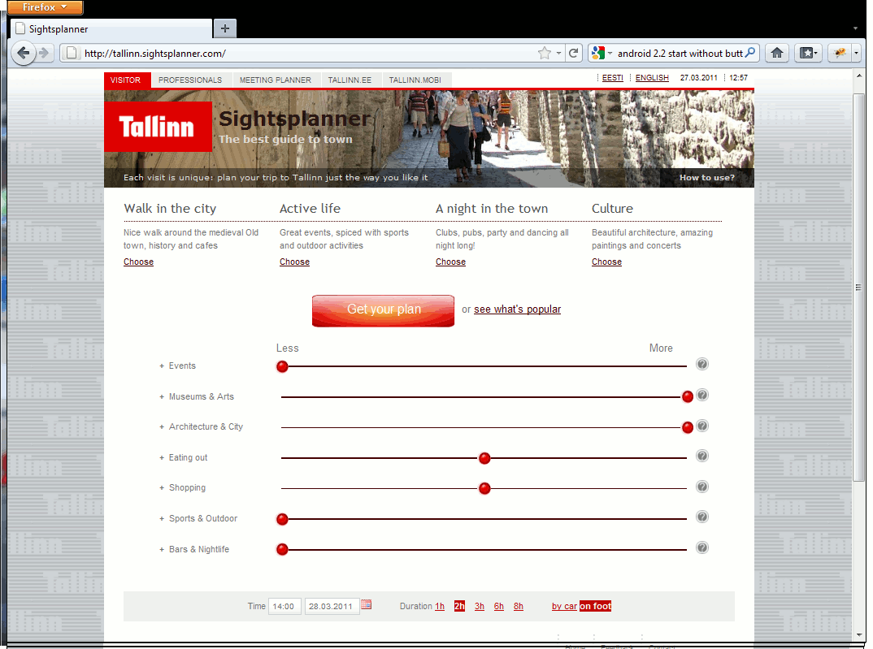
Notes:
20

Slide 21
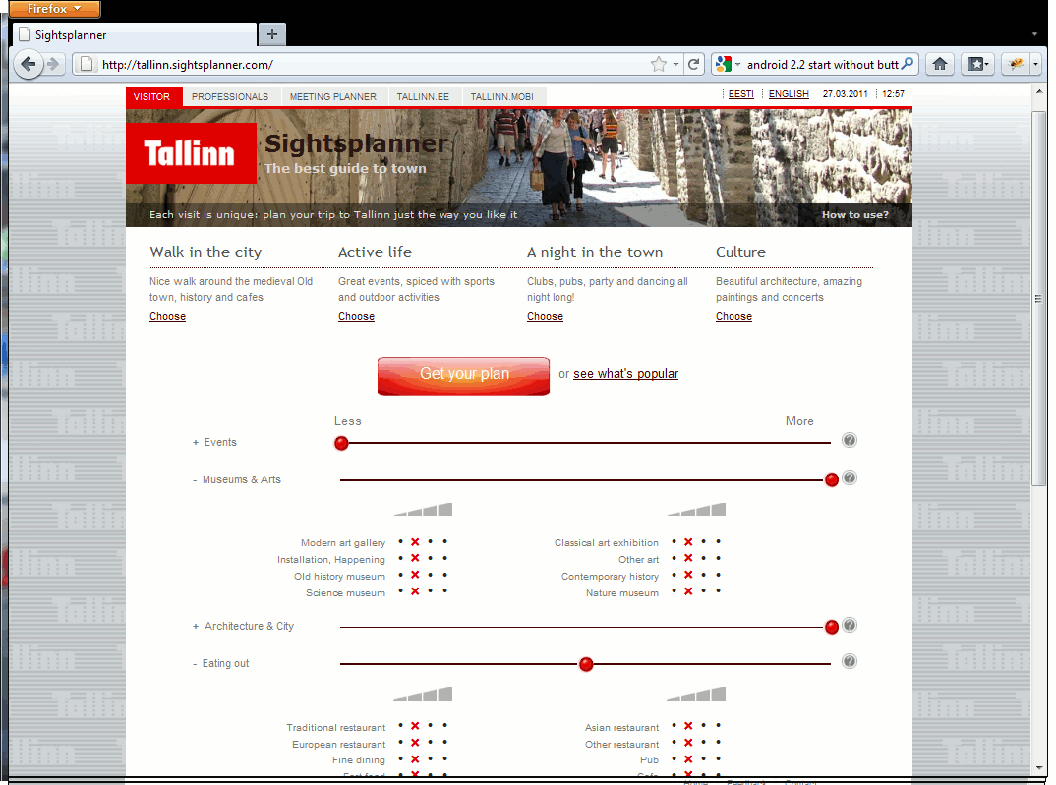
Notes:
21

Slide 22
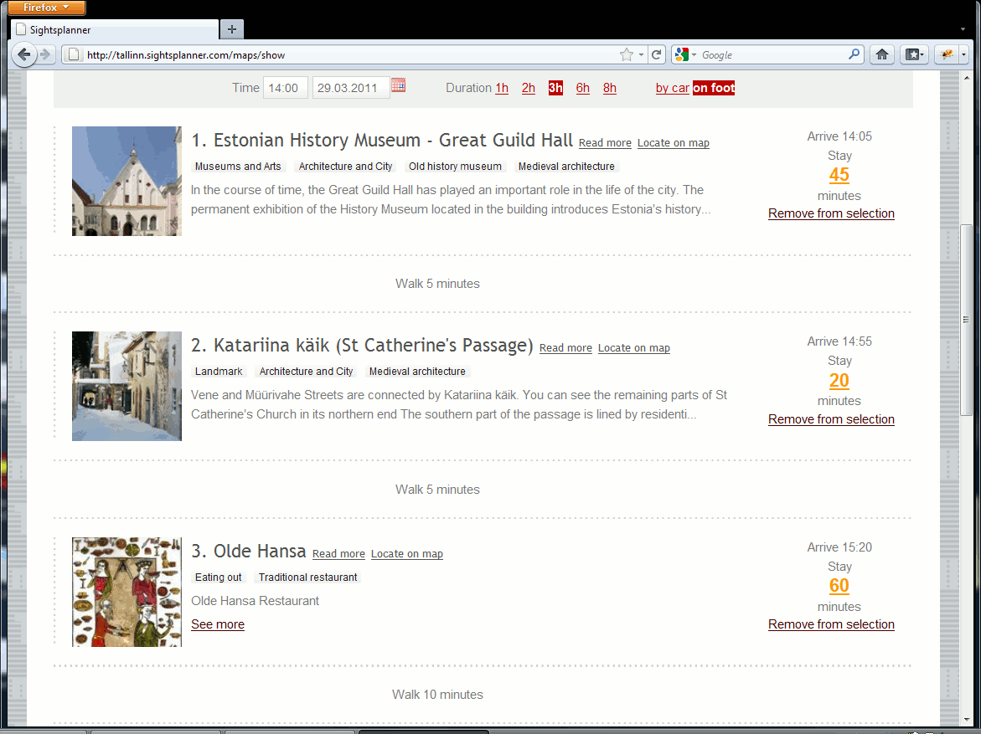
Notes:
22

Slide 23
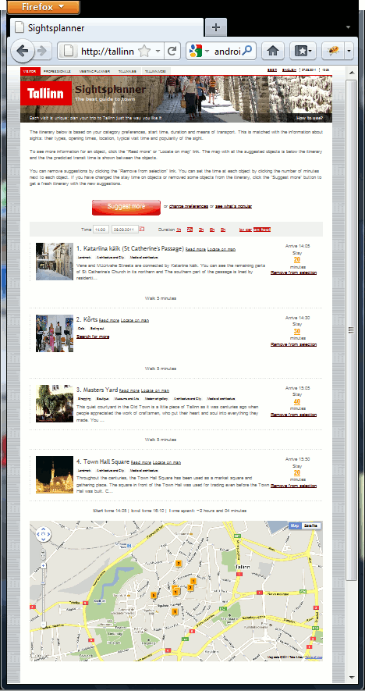
Notes:
23

Slide 24
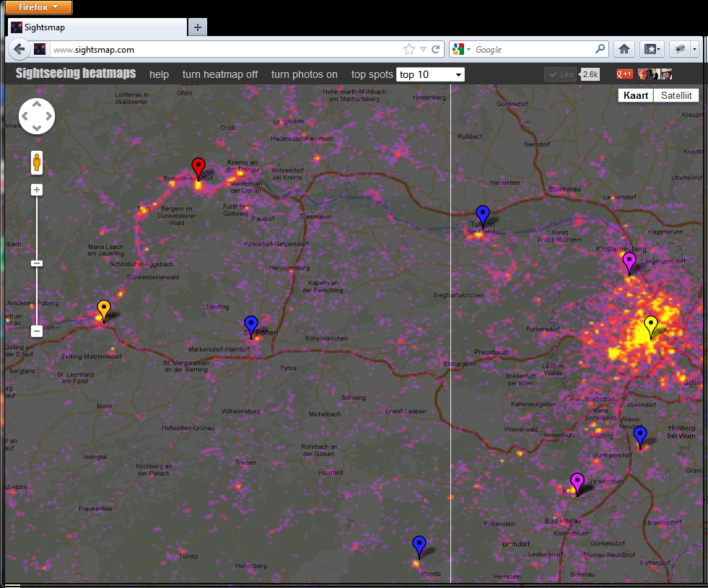
Notes:
24

Slide 25
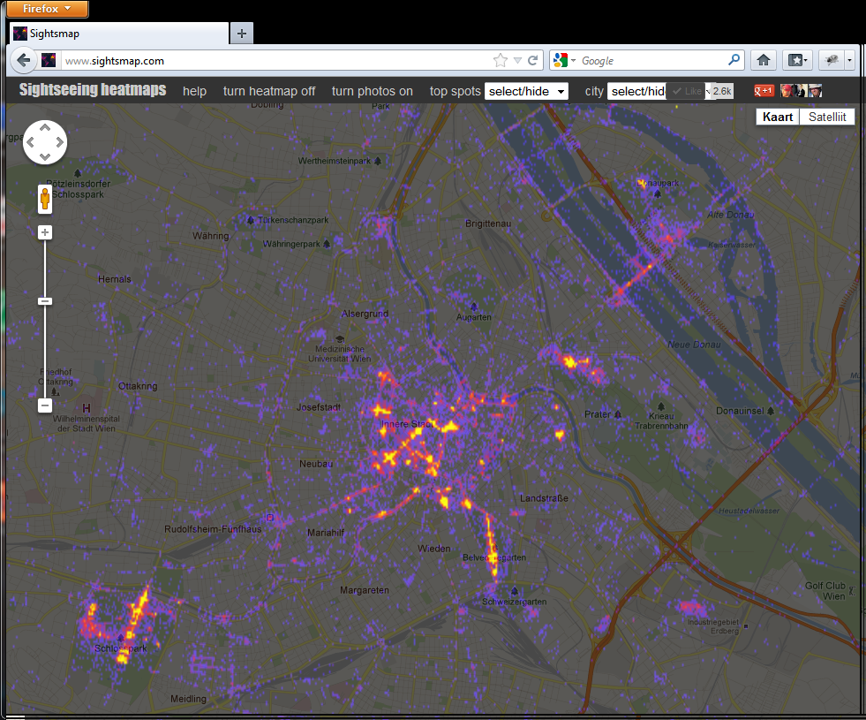

Slide 26
Input 1
User interests:
likes(john,nightlife,0.6)
likes(john,sports,0.8)
likes(john,music,0.7)
likes(john,heavymetal,0.9)
dislikes(john,classicalmusic,0.9)

Slide 27
Input 2
Object properties:
type(omalley,bar,0.9)
activity(omalley,footballwatching,0.7)
popularity(omalley,1000)
type(crown,restaurant,1.0)
activity(crown,heavymetal,0.8)
popularity(crown,1500)
opentime(crown,12.00,0.9)

Slide 28
Input 3
Knowledge about the world:
type(X,church,M) -> type(X,architecture,M*0.9)
type(X,bar,M) -> type(X,drinkingplace,M)
type(X,restaurant,M) -> type(X,drinkingplace,M*0.7)
activity(X,footballwatching,M) -> activity(X,sports,M)
type(X,fastfood,M) -> visitminutes(X,20,0.8*M)
type(X,bar,M) & M>0.75 -> openat12(X,0.85)
description(X,S) & contains_str(S ,“paintings“) & contains_str(S ,“gallery“) ->
type(X,artcollection,0.8)

Slide 29
Output
Recommendations: numerical ranks for all tourism objects:
rank(john,omalley,0.6)
rank(john,crown,0.5)

Slide 30
Reasoning tasks
Object identities: are two objects A and B obtained from different sources actually equal?
Object types from content: using title, abstract, source etc, calculate wheather the object is a city, a castle, a church, medieval, modern, a drama play, a classical music concert, a rock concert, ...
Generalised object types: if we know that an object is a bar (with some confidence X), then it is also a nightlife spot (with some confidence Y)
Additional properties like time of visit, opening times
How well does an object match user preferences
Notes:
30

Slide 31
Probabilities?
There is a large number of probability-oriented theories and several reasoning systems, yet no “mainstream” probabilistic rule-based derivation algorithms exist
Fuzzy logic, probabilistic logic, Bayes networks, ....
Probabilistic datalog, probabilistic prolog, ...
Mycin, Emycin, Cadiag-2, ...
Notes:
31

Slide 32
Goal
Formulate a practical, correct and complete way to use probabilities in rules for the (tourism) recommender context, using object logic.
Metalogic:
0.9: type(X,church) -> type(X,architecture)
0.8: type(X,fastfood) -> visitminutes(X,20)
Object logic:
type(X,church,M) -> type(X,architecture,M*0.9)
type(X,fastfood,M) -> visitminutes(X,20,M*0.8)
Notes:
32

Slide 33
Which kinds of probabilities?
Non-strict sets a la „blue“, „large“, ...
Fuzzy logic : p(A v B) = max(p(A),p(B))
0.95: type(X,church) -> type(X,architecture)
0.7: type(X,theatre) -> type(X,architecture)
Incomplete knowledge a la „not sure that“ ...
Probabilistic: p(A v B) = p(A)+p(B) – (p(A)*p(B))
0.8: type(X,bar) -> openat12(X)
Object logic:
type(X,church,M) -> type(X,architecture,M*0.9)
type(X,fastfood,M) -> visitminutes(X,20,M*0.9)
Notes:
33

Slide 34
Object logic layers of interpretation
Pred(t): Pred(t) holds.
Pred(t,m): Pred(t) holds with a fuzzy measure at least m.
Pred(t,m,c): With confidence (probability) at least c,
Pred(t) holds with at least a fuzzy measure m.
Pred(t,m,c,d): The fact "with confidence (probability) at
least c, Pred(t) holds with at least a fuzzy
measure m„ holds and depends on the set of
clauses d.
Notes:
34

Slide 35
Examples
bar(malloy,0.9,1): we are certain that malloy is bar
with a fuzzy measure at least 0.9
bar(crown,0.9,0.8): we are 0.8 confident that crown is
a bar with a fuzzy measure at least 0.9
Notes:
35

Slide 36
Rule examples
bar(X,M,C) & M>L -> openat12(X,1,C*0.8):
when we have confidence C in that X is a bar with a
measure M at least L, we are C*0.8 confident
that it is open at 12 with a measure 1.
optionally
bar(X,M,C) -> openat12(X,1,M*C*0.8):
example of a sure rule:
bar(X,M,C) -> can_eat_at(X,M*0.5,C):
Notes:
36

Slide 37
Fuzzy part is easy
Use your own preferred function f and limits for fuzzy derivation
Pred(X,M1) & Pred(X,M2) -> Pred(X, f(M1,M2))
Pred(X,M) & M>L -> Pred(X, f(M))
Standard derivation rules in resolution hold, nothing is added.
We can enhace subsumption, provided f is monotonic:
Pred(X,M1) subsumes Pred(Y,M2) iff Y=Xs and M1>=M2.
Notes:
37

Slide 38
Probabilistic part requires tracking
Recall P(t,M,C,D): C is the probability and D is the set of facts on which the atom depends upon.
Always use rules of form
P(....,D1) & ... & P(...,Dn) & A1 & .... & An ->
P(....,union(D1,...,Dn))
where P atoms do contain probabilities and
A1 ... An do not contain probabilities
Notes:
38

Slide 39
Multiplying probabilities
Generally the rules should have a form
P1(t1,M1,C1,D1) & ... & Pn(tn,Mn,Cn,Dn) ->
P(t,M,f(M1,...,M2),g(C1,...,Cn,D1,...,Dn),union(D1,...,Dn))
In simple cases g(C1,...,Cn,D1,...,Dn) = C1*...*Cn
However, if intersection(D1,....,Dn) is not empty, Ci-s corresponding to Di-s with multiple occurrences should be used only once
Notes:
39

Slide 40
Cumulating evidence
Use evidence cumulating rule schema:
Pred(X,M1,C1,D1) & Pred(X,M2,C2,D2) &
Empty(Intersection(D1,D2))
->
Pred(X,min(M1,M2),(C1+C2)-(C1*C2),union(D1,D2))
Notes:
40

Slide 41
Cumulating evidence
Example: independent facts
a) bar(X,M,C,D) & M>0.75 -> openat12(X,1,C*0.8,D)
b) intitle(X,"allnight",M,C,D) & M>0.75 -> openat12(X,1,C*0.9,D)
c) bar(malloy,1,1,{c}).
d) intitle(malloy,"allnight",1,1,{d}).
a,c: e) openat12(malloy,1,0.8,{c})
b,d: f) openat12(malloy,1,0.9,{d})
giving for our case (0.8+0.9=1.7, 0.8*0.9=0.72, 1.7-0.72=0.98)
openat12(malloy,1,0.98,{c,d})
Notes:
41

Slide 42
Cumulating evidence
Example: dependent facts
f) activity(X,heavymetal,1,1,D) -> activity(X,music,1,1,D).
g) activity(X,Y,M1,C1,D1) & likes(U,Y,M2,C2,D2) ->
fits(U,X,1,M1*M2*C1*C2,union(D1,D2))
a) likes(john,music,1,0.6,{a})
b) likes(john,heavymetal,1,0.8,{b})
c) activity(crown,heavymetal,1,1,{c}).
c,f: h) activity(crown,music,1,1,{e}).
g,a,h(cf): i) fits(john,crown,1,0.6,{a,c})
g,b,c: j) fits(john,crown,1,0.8,{b,c})
Cumulating prohibited, since i and j share c
Notes:
42

Slide 43
Ranking calculation in meta-logic
Derive all open-at-time facts.
Derive all independent addrank facts, using:
Popularity(X,P) -> addrank(X,pf(P))
Likes(X,Y,M1) & assoc(Z,Y,M2,C,D) ->
addrank(X,Z,f(M1,M2,C),D)
Dislikes(X,Y,M1) & assoc(Z,Y,M2,C,D) ->
addrank(X,Z,nf(M1,M2,C),D)
Sum all maximal pos/neg addrank numbers for objects.
Filter out objects which are open at time.
Order by rank.
Notes:
43

Slide 44
Summary 1
Represent facts as P(t,M,C,D) where:
M- fuzzy measure of P(t) holding
C – confidence as probability of at least P(t,M)
holding
D – set of facts on which P(t,M,C) depends
Represent rules as
P1(t1,M1,C1,D1) & ... & Pn(tn,Mn,Cn,Dn) &
M1>L1 & ... & Mn>Ln & A1 .... & Am
->
P(t,M,f(M1,...,M2),g(C1,...,Cn,D1,...,Dn),union(D1,...,Dn))
Notes:
44

Slide 45
Summary 2
Add evidence cumulating rule
Pred(X,M1,C1,D1) & Pred(X,M2,C2,D2) &
Empty(Intersection(D1,D2))
->
Pred(X,min(M1,M2),(C1+C2)-(C1*C2),union(D1,D2))
Add extended subsumption
Pred(X,M1,C1,D1) subsumes
Pred(Y,M2,C2,D2 )
iff Y=Xs & M1>=M2 & C1>=C2 &
D1 is a subset of D2
Notes:
45

