Slide 1
Knowledge representation
lecture 7
Some applications
of first order provers
https://i.redd.it/4i4uv8qsh7yz.gif
Tanel Tammet
TTU

Slide 2
Lecture overview
Recall: three main kinds of reasoners (there ar e others ...)
An overview of using first order provers: where and how
Using provers in various kinds of mathematics
Nontrivial examples with Otter
Formal verification
Using provers for commonsense reasoning in natural language processing

Slide 3
Three main kinds
First order aka predicate logic (for classical logic)
Propositional logic
SMT (satisfiability modulu theories): prop logic + limited, computable parts of first order logic

Slide 4
About propositional and SMT
Juhan Ernits will talk about the applications in the next lecture

Slide 5
First order logic applications
Very rarely used in actual commercial software development.
Why: part of AI, not something you can easily use for creating a user interface or reports etc.

Slide 6
First order logic and learning?
What makes logic hard: writing rules.
Normal people have really hard time encoding knowledge in formal rules.
Additionally, real-life rules are probabilistic/fuzzy, not certain.
Hence, real hope or need is to start learning rules!
Once we have learned lots of rules, we could start using the rules, i.e. deriving new information.

Slide 7
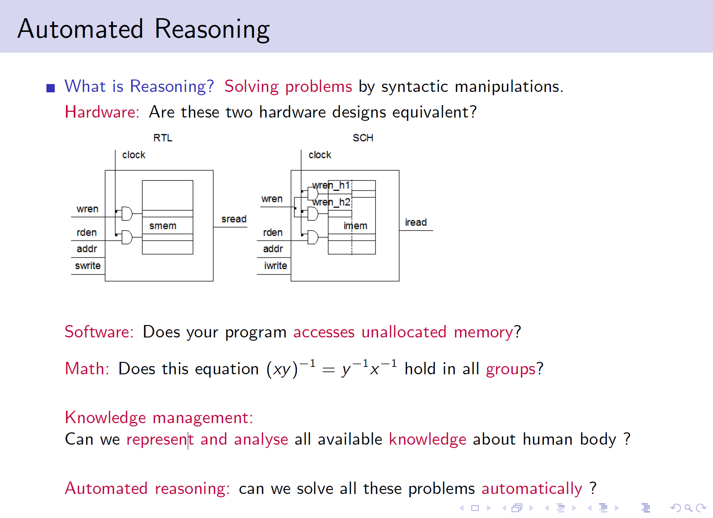
First order logic and learning?
a

Slide 8
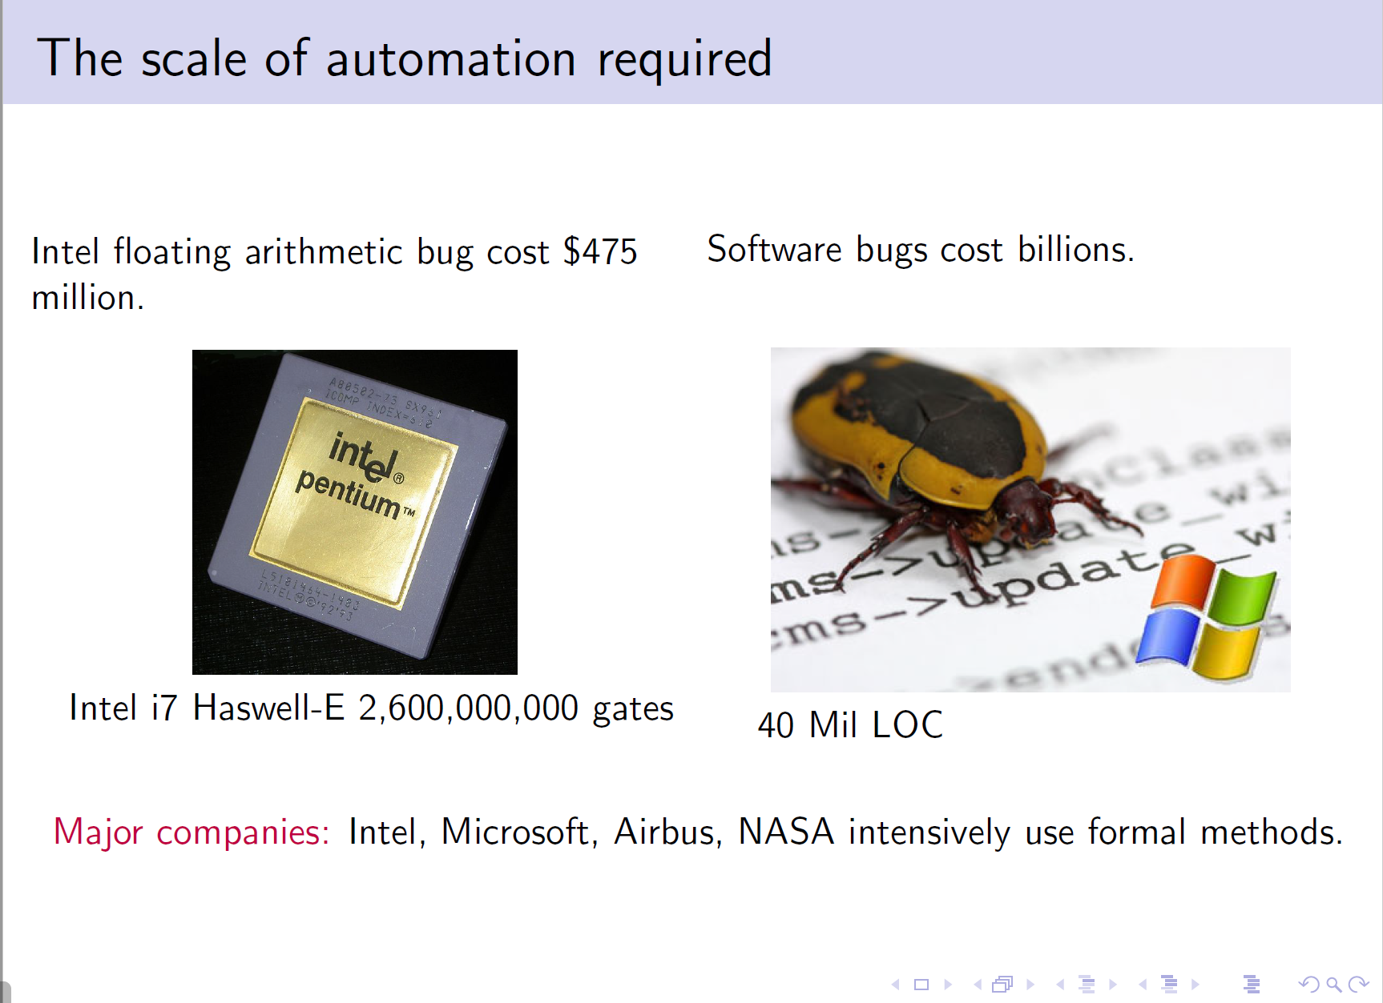
First order logic and learning?
a

Slide 9
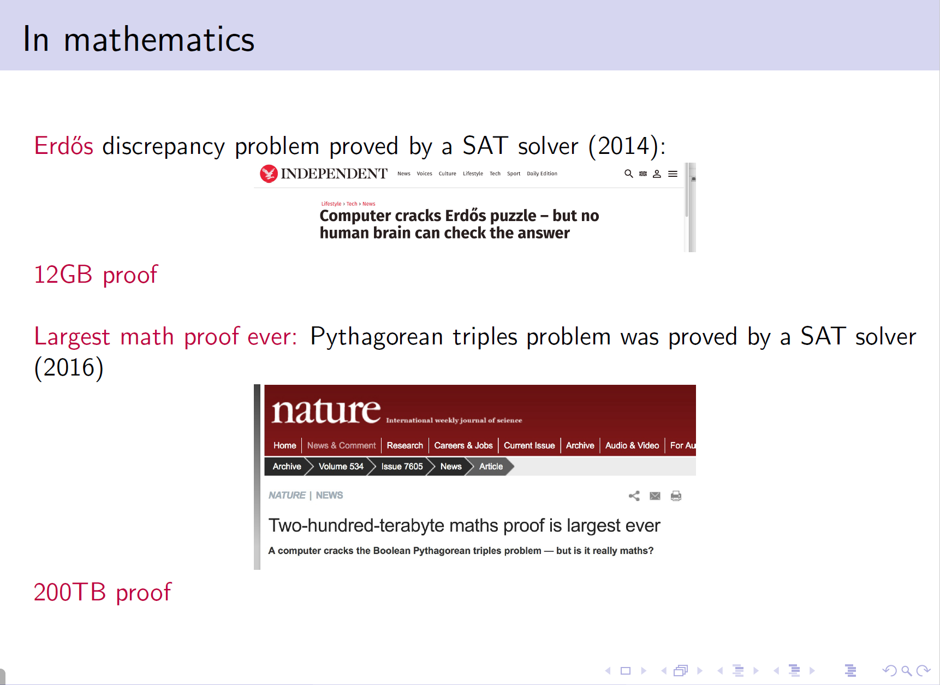
First order logic and learning?
a

Slide 10
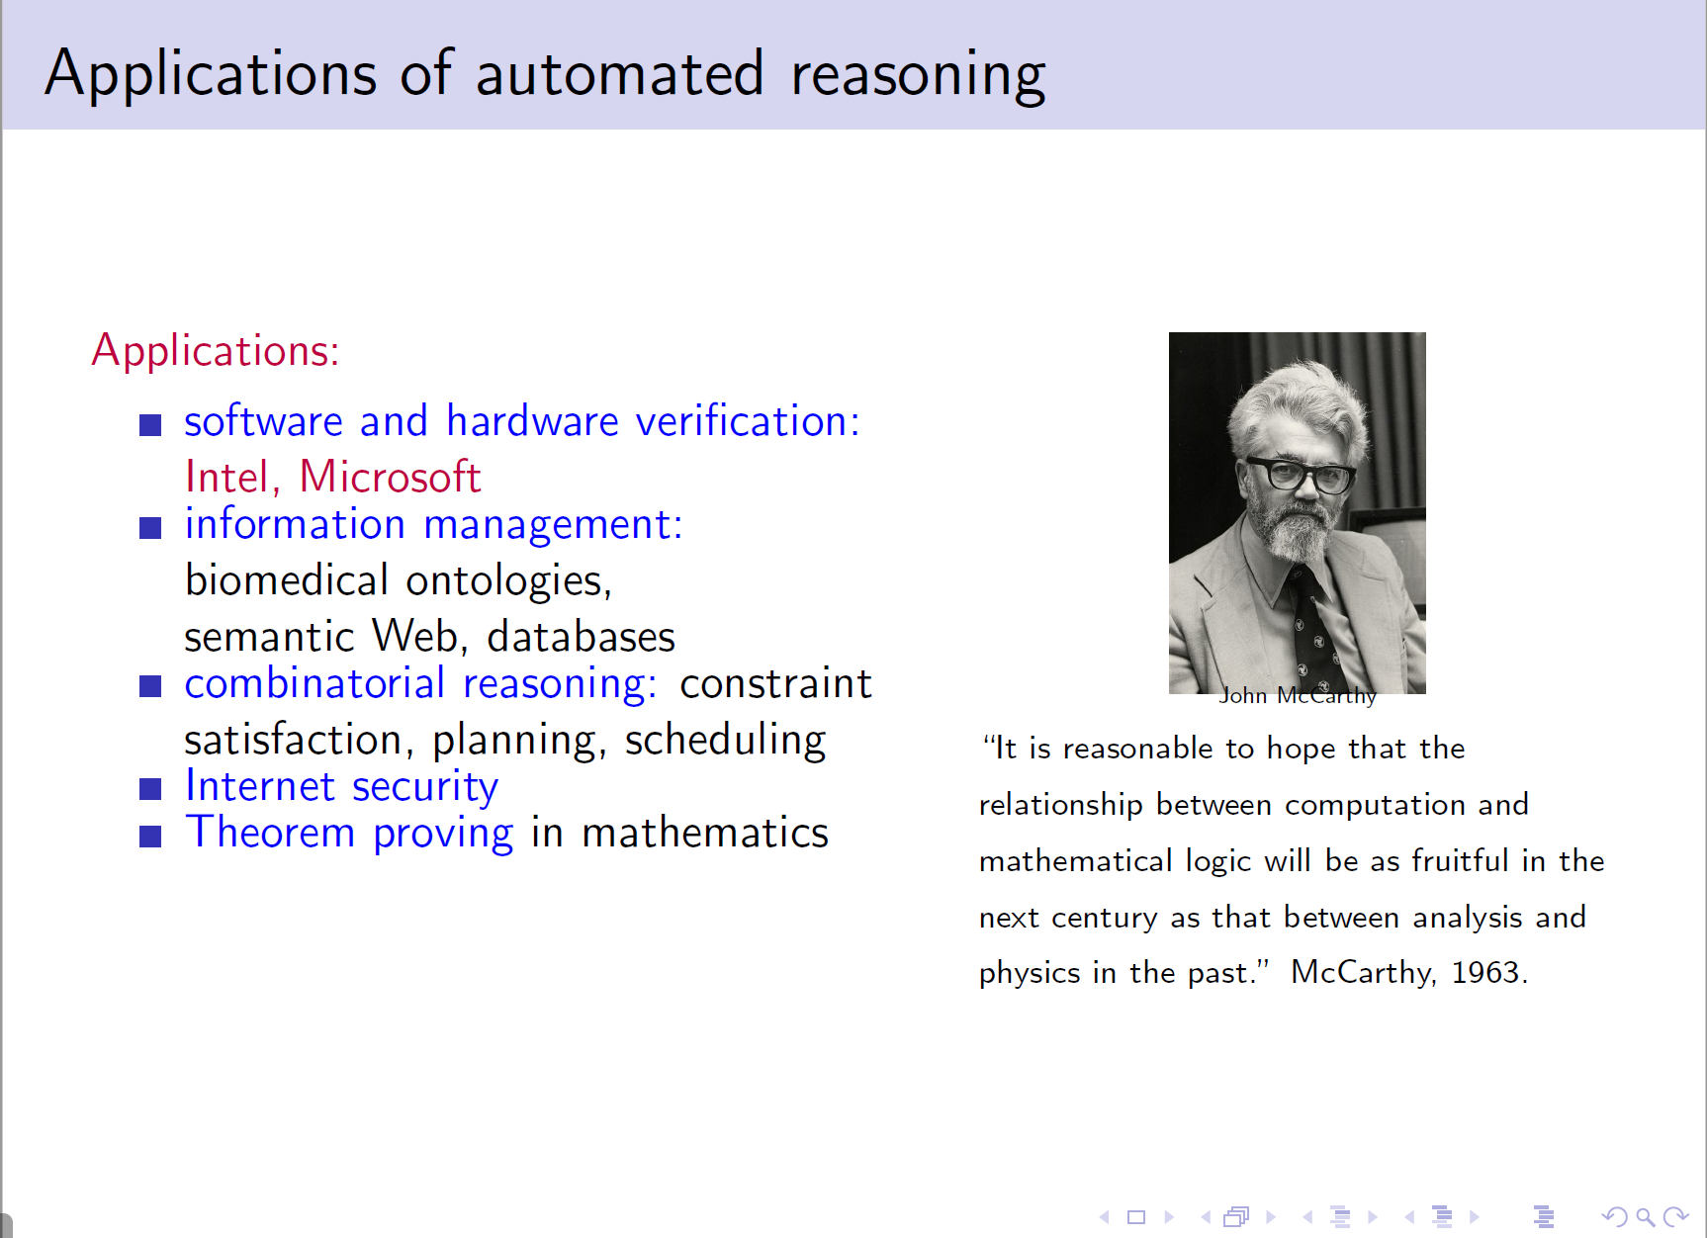
First order logic and learning?
a

Slide 11
Realities
Provers are – in an important sense – incredibly weaker than a brain.
Real mathematics (what mathematicians do) is very hard. Provers have managed to solve open problems only some rare cases.
Even mathematics is very hard to formalize, though doable.
Formalizing electronics is sometimes feasible, but really hard. In these cases prop solvers and SMT solvers work best.
We do not understand well how to fomalize common sense thinking.
Common sense thinking relies on an enormous amount of uncertain rules.

Slide 12
Hope!
Maybe we can learn commonsense rules using specialized learning techniques.
In parallel, maybe we can start automatically reading simple texts and automatically building statistical rules for commonsense reasoning.
After that we could use automated reasoning as a method for applying statistical rules we have learned.

Slide 13
Examples from mathematics
Can we axiomatize „all mathematics“ at once?
Two answers:
Gödel taught us that mathematics is not finitely axiomatizable.
However, very large sensible parts have been axiomatized. See eg set theory in first order logic:
  https://en.wikipedia.org/wiki/Zermelo%E2%80%93Fraenkel_set_theory
  http://www.cs.miami.edu/~tptp/cgi-bin/SeeTPTP?Category=Axioms&File=SET009^0.ax
  http://www.cs.miami.edu/~tptp/cgi-bin/SystemOnTPTP look for SET...

Slide 14
TPTP
TPTP: the largest existing set of formalized first order problems
http://www.cs.miami.edu/~tptp/
along with
converters
an online tool capable of running all the top-level provers over the web interface.
yearly prover competitions http://www.cs.miami.edu/~tptp/CASC/
see also http://www.satcompetition.org/ for SAT competitions

Slide 15
Some nontrivial examples for otter
Let us examine
http://lambda.ee/w/images/0/03/Problems.tar.gz
Check these recommendations:
http://lambda.ee/wiki/Soovitusi_Otteri_otsingu_suunamiseks

Slide 16
Classic otter prover doing math
Old results:
http://www.mcs.anl.gov/research/projects/AR/new_results/
Famous result: open problem - Robbins algebra ... – solved
http://www.cs.unm.edu/~mccune/papers/robbins/
„See Otter digging for algebraic pearls“:
http://www.math.md/files/qrs/v10-n1/v10-n1-(pp95-114).pdf

Slide 17
Induction!?
Let us define the properties of a list member function m where c adds a new element to the list. n stands for empty list and
a list [1,5] is represented as c(1, c(5, n))
-m(X,n).
m(X,c(X,Y)).
X=Z | m(X,Y) | -m(X,c(Z,Y)).
-m(X,Y) | m(X,c(Z,Y)).
Your goal is to prove that m has the expected property;
All x All y Exists z All u ((m(u,x) & m(u,y)) <=> m(u,z))

Slide 18
Induction!?
We need to prove two statements:
Induction base:
All y Exists z All u ((m(u,n) & m(u,y)) <=> m(u,z))
where n stands for empty list
Induction step:
All x ((All y Exists z All u ((m(u,x) & m(u,y)) <=> m(u,z)))
=>
(All h All y1 Exists z1 All u1 ((m(u1,c(h,x)) & m(u1,y1))
<=> m(u1,z1)))
NB! There is no „easy“ way to guess what is a required base and step.

Slide 19
Formal verification

Slide 20
Verification vs. Simulation
X
(X+1)²
X²+2X+1
0
1
1
1
4
4
2
9
9
…
…
…
1
(X+1)²=(X+1)(X+1)
2
(X+1)(X+1)=(X+1)X+(X+1)1
3
(X+1)1=X+1
4
(X+1)X=XX+1X
5
XX=X²
…
….

Slide 21
Exhaustive Simulation Time
Design: a 256-bit RAM.
2²⁵⁶ = 10⁸⁰ possible combinations of initial states and inputs
Assume:
  Use all matter in our galaxy (10¹⁷ kg) to build computers.
  Each computer is of the size of single electron (10⁻³⁰ kg).
  Each computer simulates 10¹² cases per second.
  we started at the time of the Big Bang about 10¹⁰ years ago
➔ We would just have reached the 0.05% mark of completing our task

Slide 22
Detecting Design Faults
To check the new implementation for functional correctness, we need:
  a reference description:
    either a specification
    or a previous “golden” implementation.
  a new implementation, resulting from
    a refinement (synthesis) of the specification
    or an optimization of the reference implementation.
  a correctness relation which has to be established between the two specifications
    (e.g. behavioral correctness).

Slide 23
Why Formal Verification?
All Behaviors
Simulation
Formal Verification
(model checking)
Required Behaviors
reference: http://www.averant.com
Notes:
23

Slide 24
Hardware Verification
Definition: Hardware verification
  is the proof that a circuit or a system (the implementation) behaves according to a given set of requirements (the specification).
Formal verification
  uses mathematical reasoning to prove that an implementation satisfies a specification
Consideration of all cases is implicit in formal verification.

Slide 25
Formal Verification Methods
Equivalence Checking
  Compares optimized/synthesized model against original model
Model Checking
  Checks if a model satisfies a given property
Theorem Proving
  Proves implementation is equivalent to specification in some formalism
Notes:
25
Formal verification techniques use mathematical formulations to verify designs. In order to check for correctness of synthesis and optimization of models, we can use equivalence checking. We define some notion of equivalence like logic equivalence or state machine equivalence and the equivalence checker proves or disproves the equivalence of original and optimized/synthesized models.
Model checking, on the other hand, takes a formal representation of both the model and a given property, and checks if the property is satisfied by the model. Assertions that have been used for simulation can also be used as properties for model checking.
Theorem proving takes formal representations of both the specification and implementation in a mathematical logic and proves their equivalence.

Slide 26
What is Model Checking? (cont.)
  Typically used during RTL code development to debug the RTL model prior to synthesis.
  Used concurrently with and/or prior to simulation.
  FormalCheck is the name of Cadence’s Model Checking tool.
  Currently the dominant formal verification tool.
Notes:
26

Slide 27
What is Model Checking?
Relies on exhaustive state space search.
  exhaustive state space search is guaranteed to terminate, as the model is finite.
Major challenge:
  To fight state-explosion problem
Can uncover subtle design errors
Can handle large state spaces (10^120)
Quicker to start testing
  as it does not require vectors or a testbench.
Successfully used to find bugs in published standards
Notes:
27

Slide 28
What is Model Checking?
Model Checking (Property Checking):
  An automatic technique for verifying finite-state reactive systems, (such as sequential digital circuits or communication protocols).
    A reactive FSM is an FSM whose inputs come from the environment.
  For checking that a desired property holds in a finite state model of a system
  Was pioneered by Edmund Clarke, professor in the CS Dept of CMU, in 1981
      (E.M. Clarke and E.A. Emerson. "Synthesis of Synchronization Skeletons for Branching Time Temporal Logic", in Logic of Programs workshop, Yorktown Heights, NY, May 1981.).
Notes:
28

Slide 29
Applicability
Wrong assumptions:
  Formal methods can guarantee the perfectness of systems
Facts:
  can significantly enhance the trust, but not able to guarantee flawlessness.
Reasons:
  Only makes correctness statements with regard to a formal specification which can be faulty itself.
  Faults in verification program.
  Only design faults but not fabrication faults or faults during system usage.

Slide 30
Some tools
Verification Languages:
  "e".
  Synopsys Vera :
  SystemC SCV
Equivalence Checkers:
  Cadence Verplex :
  Synopsys Formality :
  Mentor FormalPro :
  Prover eCheck :
  homebrew EC
Assertion Languages:
  IBM Sugar/PSL
  0-in Checkerware
  Verplex OVL
  System Verilog SVA
  Synopsys Vera OVA

Slide 31
NLP processing

Slide 32
NLP processing
„Simple“ parts can be done using either:
„Simple“ rules (grammar, presence in Wikipedia, etc)
Statistics and learned weight networks from large annotated text corpora
Hard parts require commonsense understanding of the world:
Huge amounts of facts commonly known
Huge amounts of probabilistic/fuzzy rules
Weights for popularities, common usage patterns, etc

Slide 33
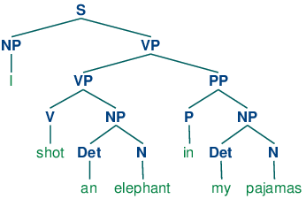
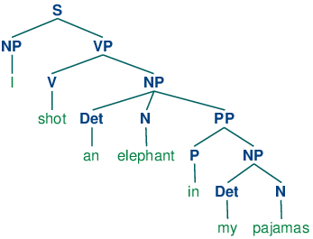
Ambiguity in grammar
Different possible parses of the sentence „I shot an elephant in my pajamas.“

Slide 34
Example
Some roles prefer to be filled by certain kinds of NPs.
This can give us useful features for classifying accurately:
  “John ate the spaghetti with chopsticks.” (instrument)
  “John ate the spaghetti with meatballs.” (patient)
  “John ate the spaghetti with Mary.”
    Instruments should be tools
    Patient of “eat” should be edible
  “John bought the car for $21K.” (instrument)
  “John bought the car for Mary.” (beneficiary)
    Instrument of “buy” should be Money
    Beneficiaries should be animate (things with desires)
  “John drove Mary to school in the van”
  “John drove the van to work with Mary.
34
Notes:
34

Slide 35
NLP processing: textual entailment
Means: commonsense derivations from text.

Slide 36
Classical Entailment Definition
Chierchia & McConnell-Ginet (2001):
A text t entails a hypothesis h if h is true in every circumstance (possible world) in which t is true
Strict entailment - doesn't account for some uncertainty allowed in applications
Page 36
Notes:
36
Related notions (implicature, pre-supposition) encompass likely inference

Slide 37
“Almost certain” Entailments
t: The technological triumph known as GPS … was incubated in the mind of Ivan Getting.
h: Ivan Getting invented the GPS.
Page 37
Notes:
37

Slide 38
Applied Textual Entailment
A directional relation between two text fragments:
Text (t) and Hypothesis (h):
t entails h (t⇒h) if humans reading t will infer that h is most likely true
Operational (applied) definition:
  Human gold standard - as in NLP applications
  Assuming common background knowledge –
  which is indeed expected from applications
Page 38
Notes:
38

Slide 39
Probabilistic Interpretation
Definition:
t probabilistically entails h if:
  P(h is true | t) > P(h is true)
    t increases the likelihood of h being true
    ≡ Positive PMI – t provides information on h’s truth
P(h is true | t ): entailment confidence
  The relevant entailment score for applications
  In practice: “most likely” entailment expected
Page 39
Notes:
39
!!!Add: the intention is to have an absolutely high value for the conditional prob, which is also a confidence value
Add assumption about prior < 1

Slide 40
The Role of Knowledge
For textual entailment to hold we require:
  text AND knowledge ⇒ h
  but
  knowledge should not entail h alone
Systems are not supposed to validate h’s truth regardless of t (e.g. by searching h on the web)
Page 40
Notes:
40

Slide 41
Gold standards
Annotated examples of text and sentence derivable from text:
Classical FRACAS example set:
https://nlp.stanford.edu/~wcmac/downloads/fracas.xml
Newer RTE example sets:
https://tac.nist.gov/data/RTE/index.html
Stanford Question Answering Dataset:
https://rajpurkar.github.io/SQuAD-explorer/

Slide 42
PASCAL Recognizing Textual Entailment (RTE) Challenges
EU FP-6 Funded PASCAL Network of Excellence
2004-7
Bar-Ilan University ITC-irst and CELCT, Trento
MITRE Microsoft Research
Page 42
Notes:
42

Slide 43
Generic Dataset by Application Use
7 application settings in RTE-1, 4 in RTE-2/3
  QA
  IE
  “Semantic” IR
  Comparable documents / multi-doc summarization
  MT evaluation
  Reading comprehension
  Paraphrase acquisition
Most data created from actual applications output
RTE-2/3: 800 examples in development and test sets
50-50% YES/NO split
Page 43
Notes:
43

Slide 44
RTE Examples
 | TEXT | HYPOTHESIS | TASK | ENTAIL-MENT
1 | Regan attended a ceremony in Washington to commemorate the landings in Normandy. | Washington is located in Normandy. | IE | False
2 | Google files for its long awaited IPO. | Google goes public. | IR | True
3 | …: a shootout at the Guadalajara airport in May, 1993, that killed Cardinal Juan Jesus Posadas Ocampo and six others. | Cardinal Juan Jesus Posadas Ocampo died in 1993. | QA | True
4 | The SPD got just 21.5% of the vote in the European Parliament elections, while the conservative opposition parties polled 44.5%. | The SPD is defeated by the opposition parties. | IE | True
Page 44
Notes:
44

Slide 45
Participation and Impact
Very successful challenges, world wide:
  RTE-1 – 17 groups
  RTE-2 – 23 groups
    ~150 downloads
  RTE-3 – 25 groups
    Joint workshop at ACL-07
High interest in the research community
  Papers, conference sessions and areas, PhD’s, influence on funded projects
  Textual Entailment special issue at JNLE
  ACL-07 tutorial
Page 45
Notes:
45

Slide 46
Methods and Approaches (RTE-2)
Measure similarity match between t and h
(coverage of h by t):
  Lexical overlap (unigram, N-gram, subsequence)
  Lexical substitution (WordNet, statistical)
  Syntactic matching/transformations
  Lexical-syntactic variations (“paraphrases”)
  Semantic role labeling and matching
  Global similarity parameters (e.g. negation, modality)
Cross-pair similarity
Detect mismatch (for non-entailment)
Interpretation to logic representation + logic inference
Page 46
Notes:
46

Slide 47
Dominant approach: Supervised Learning
Similarity Features:
Lexical, n-gram,syntactic
semantic, global
Classifier
YES
t,h
NO
Feature vector
Features model similarity and mismatch
Classifier determines relative weights of information sources
Train on development set and auxiliary t-h corpora
Page 47
Notes:
47

Slide 48
RTE-2 Results
First Author (Group) | Accuracy | Average Precision
Hickl (LCC) | 75.4% | 80.8%
Tatu (LCC) | 73.8% | 71.3%
Zanzotto (Milan & Rome) | 63.9% | 64.4%
Adams (Dallas) | 62.6% | 62.8%
Bos (Rome & Leeds) | 61.6% | 66.9%
11 groups | 58.1%-60.5%
7 groups | 52.9%-55.6%
Average: 60%
Median: 59%
Page 48
Notes:
48

